Slide 1
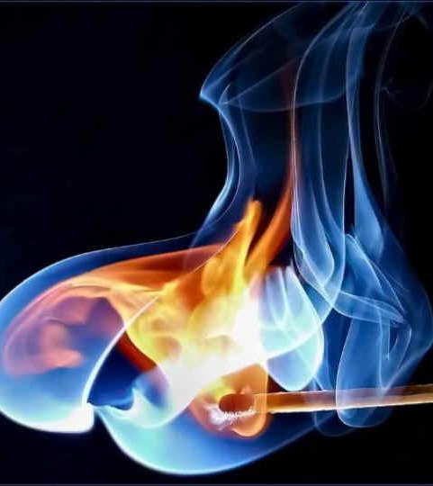
Unit 4: Thermochemistry
Topics covered
  The nature of energy
  The First Law of Thermodynamics
  Enthalpy
  Calorimetry
  Hess’s Law
  Enthalpies of formation
  Entropy (Second Law of Thermodynamics)
  Gibbs free energy

Slide 2
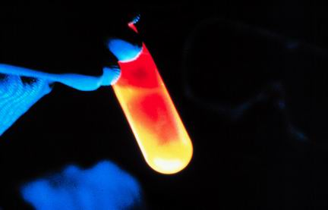
Thermochemistry
Thermodynamics is the study of energy changes
Thermochemistry studies the relationship between chemical reactions and energy changes involving heat

Slide 3
The Nature of Energy
Kinetic energy is the energy of motion
  All objects in motion have kinetic energy equal to ½mv² (m is mass and v is velocity)
  Can two objects with different masses have the same kinetic energy?
Potential energy is stored energy related to the position of an object
  A rock balancing on the edge of a cliff has potential energy due to gravity
  A stretched rubber band has potential energy due to tension and elasticity
Important to chemistry is electrostatic energy, a form of potential energy between two charged particles, such as protons and electrons
  Electrostatic energy is directly proportional to the charge of the particles, but is inversely proportional to the distance between them

Slide 4
Units of Energy
The SI unit for energy is the joule (J)
  A joule is defined as a kg•m²/s²
A commonly use non-SI unit used for energy is the calorie (cal)
  A calorie is defined as the amount of energy needed to raise 1 g of water by 1°C
  1 cal = 4.184 J (exactly)
  A nutritional calorie (Cal) is 1000 calories
    1 Cal = 1000 cal = 1 kcal

Slide 5
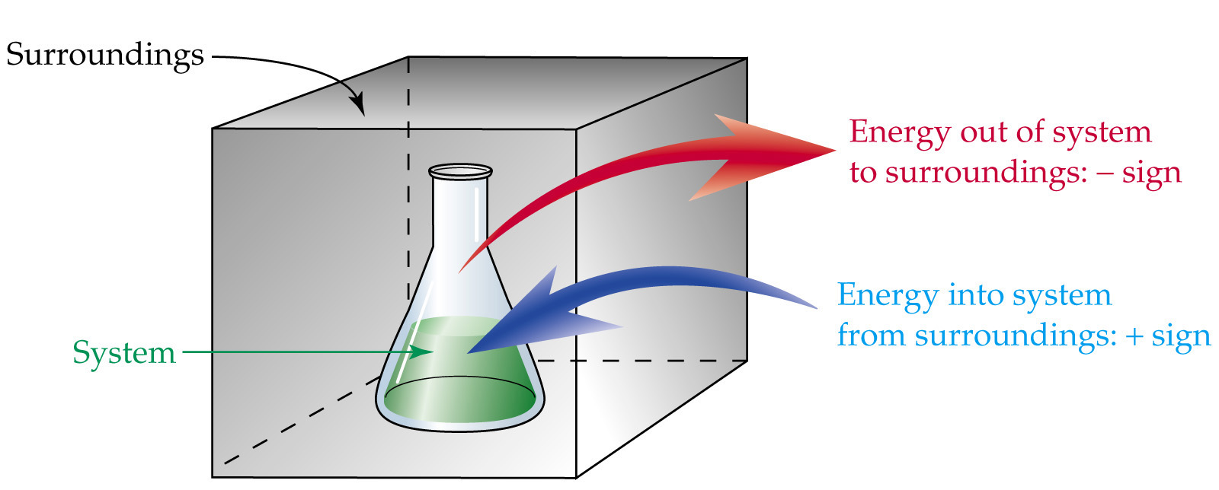
System and Surroundings
In thermodynamics, we focus our attention on a limited part of the universe called the system
Everything else is called the surroundings
In a closed system, energy but not matter can be exchanged with the surroundings

Slide 6
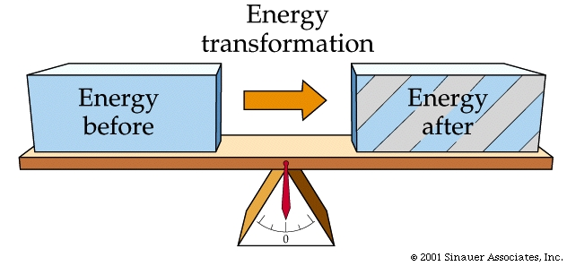
The First Law of Thermodynamics
The First Law of Thermodynamics states that energy is conserved, that any energy lost by the system must be gained by the surroundings and vice versa

Slide 7
Endothermic and Exothermic Processes
When a system absorbs heat, the process is called endothermic
A process where the system produces heat is called exothermic
Aqueous reactions can be confusing because often the reactants are considered to be the system and the water is considered part of the surroundings
  Water becomes cooler in an endothermic aqueous reaction, warmer in exothermic

Slide 8
Enthalpy
Enthalpy of reaction or heat of reaction (ΔH or ΔH_{rxn}) is the heat gained or lost during a chemical reaction
  CH₄(g) + 2O₂(g) → CO₂(g) + 2H₂O(l) ΔH = -890 kJ
  ΔH is negative, so reaction is exothermic
  Enthalpy is an extensive property, magnitude of ΔH is proportional to amount of reactant consumed
  Because 1 mol of CH₄ and 2 mol of O₂ releases 890 kJ of heat, the combustion of 2 mol of CH₄ with 4 mol O₂ would release twice as much, 1780 kJ

Slide 9
Sample Problem
CH₄(g) + 2O₂(g) → CO₂(g) + 2H₂O(l) ΔH = -890 kJ
How much heat is released when 4.50 g CH₄ is burned at constant pressure?

Slide 10
Sample Problem
CH₄(g) + 2O₂(g) → CO₂(g) + 2H₂O(l) ΔH = -890 kJ
How much heat is released when 1.00 g of water is formed at constant pressure?

Slide 11
Sample Problem
2H₂O₂ → 2H₂0 + O₂ ΔH = -196 kJ
How much heat is released when 5.00 g if H₂O₂ decomposes?

Slide 12
Enthalpy
    ΔH is equal in magnitude but opposite in sign for reverse reaction
  CH₄ + 2O₂ → CO₂ + 2H₂O ΔH = -890 kJ
  CO₂ + 2H₂O → CH₄ + 2O₂ ΔH = 890 kJ
ΔH depends on phase of reactants and products, therefore it is important to specify states in reactions
  2H₂O(l) → 2H₂O(g) ΔH = +88 kJ

Slide 13
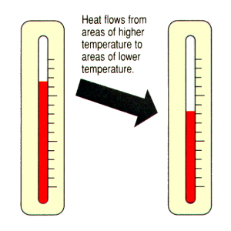
Calorimetry
Calorimetry is measurement of heat flow
A calorimeter is an instrument used to measure heat flow

Slide 14
Specific Heat Capacity
Specific heat capacity (c) is heat needed to raise 1 g of a substance by 1°C
Unit are usually J/g°C
Most of the time we are interested in calculating heat flow

Slide 15
Molar Heat Capacity
Molar heat capacity is the heat capacity of 1 mol of a substance
Units are usually J/mol-K

Slide 16
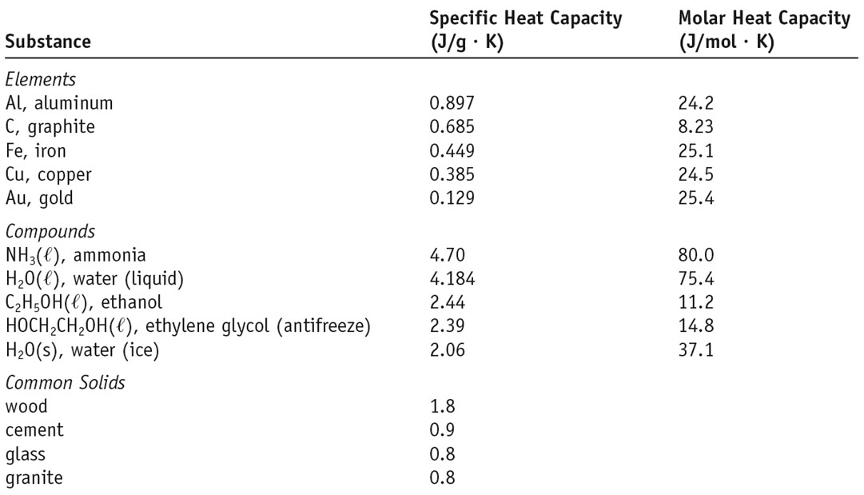
Specific and Molar Heat Capacities

Slide 17

Specific Heat Capacity
Higher specific heat means temperature is resistant to change
  More heat can be absorbed or released without a drastic change in temperature
  This is why large bodies of water regulate temperature

Slide 18
Sample Problem
How much heat is needed to warm 250 g H₂O from 22°C to 98°C?

Slide 19
Sample Problem
What is the molar heat capacity of water?

Slide 20
Constant-Pressure Calorimetry
Assume no heat lost to calorimeter or include calorimeter as part of system and calculate heat capacity of entire system
Heat gained/absorbed by the reaction will be absorbed/gained by the solution

Slide 21
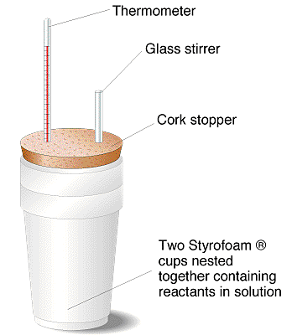
Coffee Cup Calorimeters
Simple constant-pressure calorimeters are sometimes called “coffee cup” calorimeters because of the simple materials from which they are made

Slide 22
Sample Problem
Two solutions with a combined mass of 100.0 g are mixed in a “coffee-cup” calorimeter. The temperature increases from 21.0°C to 27.5°C. How much heat was given off by the reaction? Assume no heat is lost to the surroundings and that c_{soln} = 4.18 J/g•K.

Slide 23
Constant Volume Calorimeter (Bomb Calorimeter)***

Slide 24
Sample Problem
Large beds of rocks are used in some solar-heated homes to store heat. Assume that the specific heat of the rocks is 0.82 J/g-K. Calculate the amount of heat absorbed by 50.0 kg of rocks if their temperature increases by 12 K. What temperature change would they undergo if they emitted 450 kJ of heat?

Slide 25
Sample Problem
Consider the acid-base neutralization that occurs when 0.050 mol of HCl is completely neutralized with NaOH in a constant pressure calorimeter: NaOH(aq) + HCl(aq) → H₂O(l) + NaCl(aq). Both solutions are 50.0 g and are at a temperature of 21.0°C prior to the reaction. If the final temperature is 27.5°C what is q_{rxn}? What is ΔH_{rxn}? Assume no heat loss to the surroundings and specific heat the same as pure water.

Slide 26
Hess’s Law
Hess’s law states that if a reaction is carried out in a series of steps, ΔH = sum of enthalpy changes for individual steps
  CH₄(g) + 2O₂(g) → CO₂(g) + 2H₂O(g) ΔH = -802 kJ
  2H₂O(g) → 2H₂O(l) ΔH = -88 kJ
  CH₄(g) + 2O₂(g) + 2H₂O(g) → CO₂(g) + 2H₂O(l) + 2H₂O(g) ΔH = -890 kJ
  CH₄(g) + 2O₂(g) → CO₂(g) + 2H₂O(l) ΔH = -890 kJ
Equations and ΔH values can be manipulated to solve for unknown enthalpies

Slide 27
Sample Problem
C(s) + O₂(g) → CO₂(g) ΔH = -393.5 kJ
CO(g) + ½O₂(g) → CO₂(g) ΔH = -283.0 kJ
Calculate the enthalpy of combustion of C to CO: C(s) + ½O₂(g) → CO(g)

Slide 28
Sample Problem
C₂H₂(g) + O₂(g) → 2CO₂(g) + H₂O(l) ΔH = -1299.6 kJ
C(s) + O₂(g) → CO₂(g) ΔH = -393.5 kJ
H₂(g) + ½O₂(g) → H₂O(l) ΔH = -285.8 kJ
Calculate ΔH for: 2C(s) + H₂(g) → C₂H₂(g)

Slide 29
Enthalpies of Formation
Enthalpy of formation ( ) is the enthalpy change when a compound is formed from its elements
  Units are kJ/mol
Standard enthalpy of formation ( ) is when reactants and products are in standard states, i.e. its pure form at 1 atm and 298 K (25°C)

Slide 30
Standard Enthalpy of Formation
2C(graphite) + 3H₂(g) + O₂(g) → C₂H₅OH(l)
  = -277.7 kJ
  Under standard conditions, graphite and diatomic forms are the most stable forms of the elements
  The standard enthalpy of formation for the most stable form of any element is zero
  Tables of standard enthalpies of formation for most compounds are available

Slide 31
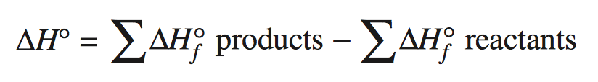
Standard Enthalpy of Reaction
Standard enthalpy of formation can be used to find the enthalpy of a reaction under standard conditions
You must multiply enthalpies by stoichiometric coefficients

Slide 32
Sample Problem
Find the standard enthalpy of reaction for the following: C₃H₈(g) + 5O₂(g) → 3CO₂(g) + 4H₂O(l)

Slide 33
Sample Problem
Find the standard enthalpy of reaction for the following: C₆H₆(l) + O₂(g) → 6CO₂(g) + 3H₂O(l)

Slide 34
Sample Problem
Find the standard enthalpy of reaction for the combustion of one mol of liquid ethanol, C₂H₅OH (assume liquid water is formed)

Slide 35
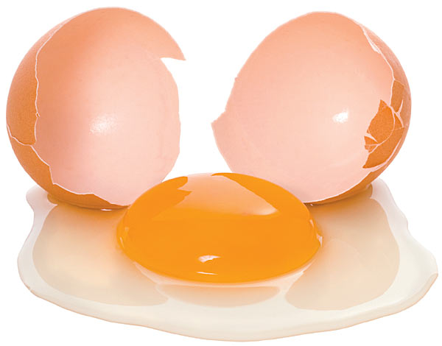
Spontaneous Processes
Certain processes always occur under a given set of circumstances
Spontaneous processes always have direction
  An egg breaking, nail rusting, balloon deflating

Slide 36
Spontaneous Processes
Lowering energy is favorable for spontaneous processes, but cannot be the only factor that determines spontaneity
Some processes depend on temp.
  When T > 0°C, ice spontaneously melts
  When T < 0°C, water spontaneously freezes
For other processes, energy and temperature do not provide an adequate explanation

Slide 37
Spontaneous Processes
Consider the following:
Why does the gas spontaneously expand, but never spontaneously reverse?
Processes in which the disorder of a system increases tend to occur spontaneously

Slide 38
Entropy
Entropy (S) is the measure of disorder in a system
  ΔS = S_{final} – S_{initial}
  If the disorder of a system increases, ΔS is positive
  If disorder decreases, ΔS is negative
  Units are J/K

Slide 39
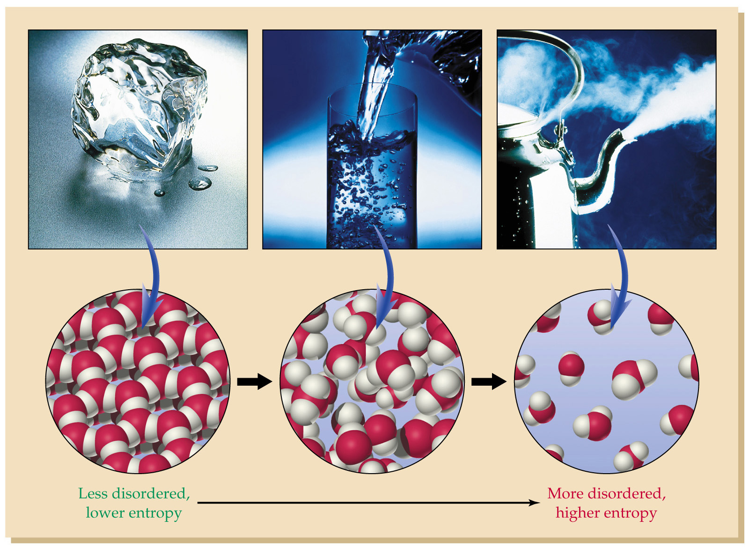
Entropy and Phase Change

Slide 40
Sample Problem
Predict if ΔS is positive or negative
  H₂O(l) → H₂O(g)
  Ag⁺(aq) + Cl⁻(aq) → AgCl(s)
  4Fe(s) + 3O₂(g) → 2Fe₂O₃(s)

Slide 41
Second and Third Laws of Thermodynamics
The second law of thermodynamics states that the entropy of the universe increases with any spontaneous process
  Entropy is not conserved
  No process that produces order (-ΔS) can proceed without producing equal or greater disorder in its surroundings
The third law of thermodynamics states that the entropy of a pure crystalline substance at 0 K is zero

Slide 42
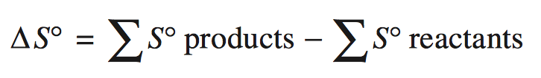
Entropy Changes in Chemical Reactions
Standard molar entropy (S°) is the molar entropy values of substances in their standard state, units are J/mol•K
  S° for elements at 298 K is not zero
  S° gas > liquid > solid
  S° generally increases with increasing molar mass
  S° generally increases with increasing number atoms

Slide 43
Sample Problem
Calculate ΔS° for synthesis of ammonia gas from hydrogen and nitrogen gas

Slide 44
Sample Problem
Calculate ΔS° for the following: Al₂O₃(s) + 3H₂(g) → 2Al(s) + 3H₂O(g)

Slide 45

Gibbs Free Energy
Gibbs free energy (G) is a function used to predict whether a reaction will be spontaneous
  If ΔG is (-), rxn spontaneous in forward dir.
  If ΔG is zero, rxn is at equilibrium
  If ΔG is (+), rxn is nonspontaneous, work must be done by surroundings, reverse rxn will be spontaneous

Slide 46

Standard Free Energy Changes
All compounds have a standard free energy of formation (ΔG°_{f})

Slide 47
Sample Problem
Calculate the standard free energy of formation for P₄(g) + 6Cl₂(g) → 4PCl₃(g)
Is the reaction spontaneous under standard conditions?

Slide 48
Free Energy and Temperature
Temperature often affects whether or not a reactions will be spontaneous
If we assume ΔH° and ΔS° (which can be easily calculated from tables) do not change with temperature, we can estimate ΔG very accurately at temps. other than 298 K
ΔG = ΔH° - TΔS°
ΔG = ΔH – TΔS = ΔH + (-TΔS)

Slide 49
Sample Problem
Estimate the values of ΔG at 25°C and 500°C for the Haber process for the production of ammonia: N₂(g) + 3H₂(g) → 2NH₃(g). At what temperature would the reaction stop being spontaneous?

Slide 50
Sample Problem
Estimate the value of ΔG at 400 K for the following: 2SO₂(g) + O₂(g) → 2SO₃(g)

